Slide 1

PICO SSCS Aristotle University of Thessaloniki novel boost converter for battery-powered IoT applications
Team members
B. Eng. Kontogiannis Stefanos
M. Eng. Andreas Tsiougkos
B. Eng. Nikos Ladias
Notes:
Hello everyone, this is team Greece, and we will present our novel boost converter topology designed in Skywater130 technology.

Slide 2
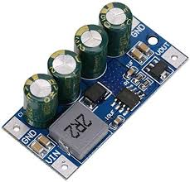
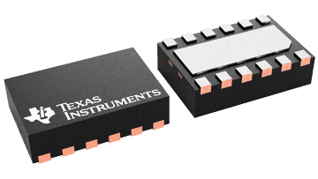
State-of-the-art LDO/DC-dc converters
Increasing need for efficient power management
E.g., due to IoT evolution
Improved lifecycle product management, maintenance costs
Typical power converter circuits
PWM boost/buck converters
Switched Capacitor / Charge Pump
Boost Converter by OEM manufacturer for Wal Front
Texas Instruments TPS 61094 PWM Boost control module
New novel boost converter topology​
Non PWM, high load current, operating at low battery voltages​
Notes:
1 min

Slide 3
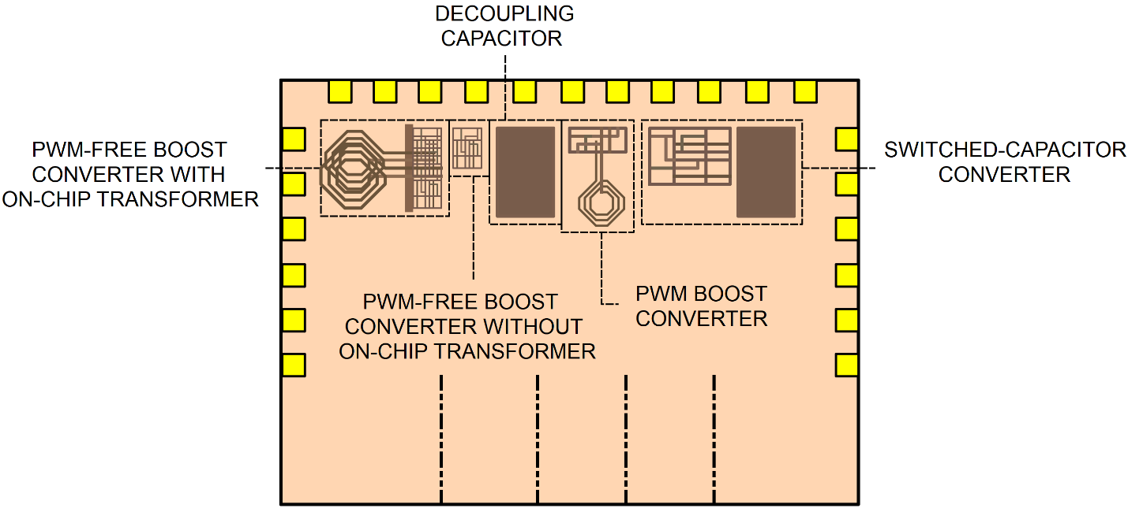
Design Summary and Goals
Comparison among the non-PWM boost converter and the other topologies
Explore/investigate various load currents and minimum output voltages
Measure power efficiency, load regulation, quiescent current
1.5 V battery source scenario → Input voltage drops due to the battery’s gradual discharge
Four circuit blocks
Notes:
This project aims to evaluate a novel non-PWM boost converter for extending battery life in IoT applications. The proposed converter will be compared to a traditional PWM boost converter and a switched-capacitor boost converter. The purpose is to perform a comparative analysis between the non-PWM boost converter and the other topologies for a 1.5 V battery source scenario in order to demonstrate the significance and, possible, limitations of the non-PWM boost converter via the metrics of power efficiency, load regulation, and quiescent current. We aim to compare their performance characteristics for various load currents and minimum output voltages and examine their peak efficiency as the input voltage drops due to the battery gradual discharge, thus concluding the useful lifetime they allow when leveraged by our converter.

Slide 4
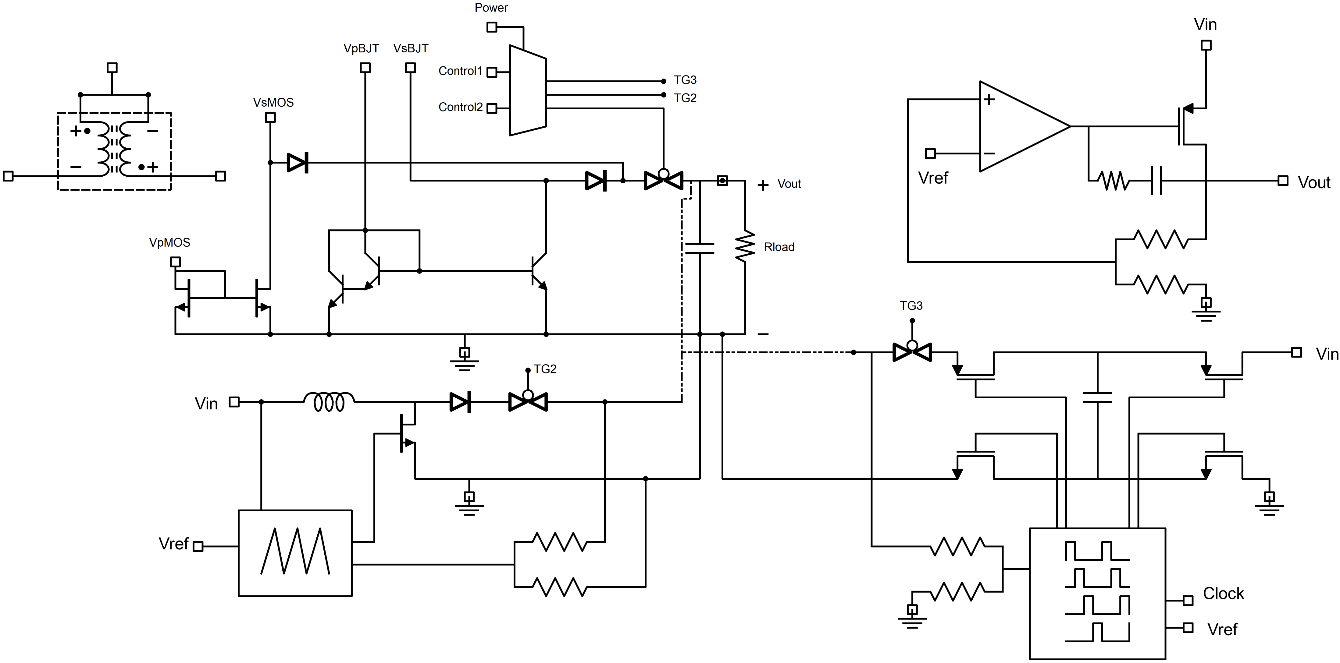
System Block Diagram
Notes:
Run through the circuits.
Common output node isolated through diodes and transmission gate

Slide 5
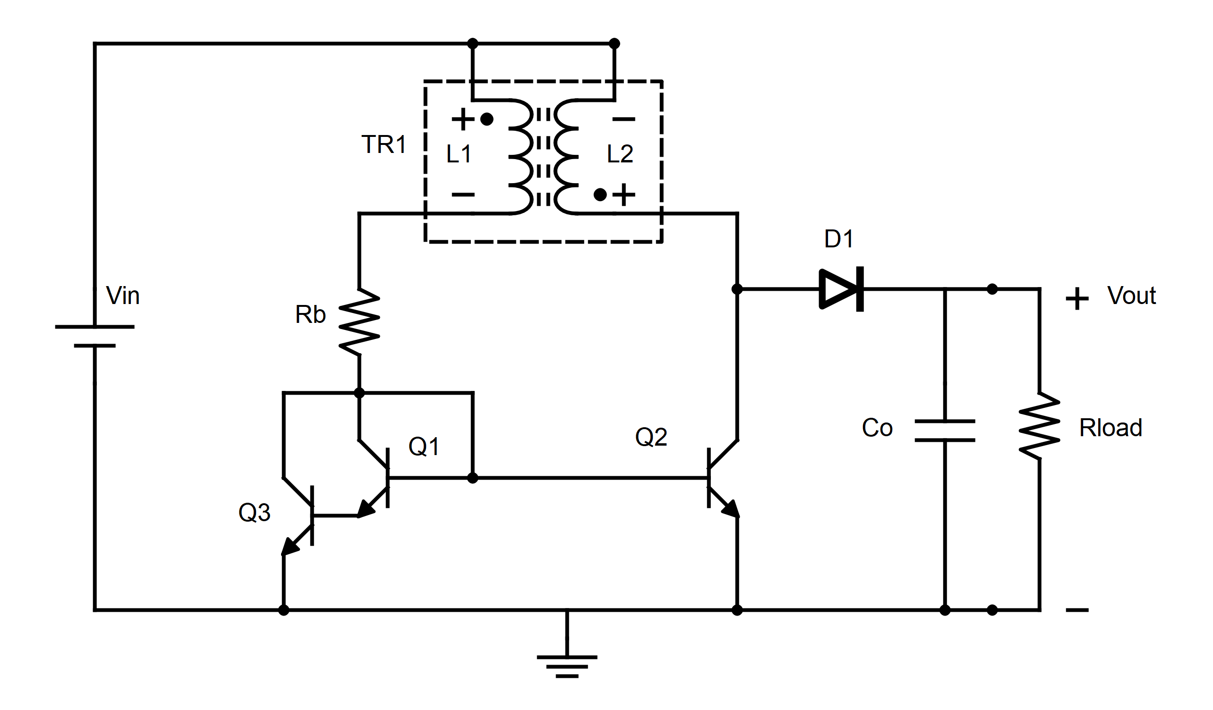
Non-PWM Boost Converter
BJT current mirror
Transformer → Positive feedback
Frequency related to transformer parameters
Supplementing with external transformer
Notes:
The circuit consists of a bipolar junction transistor current mirror connected to a transformer with inverted secondary coil, as shown, forming a closed loop and generating positive feedback for voltage boosting. The current mirror transistor on the output side is driven by a pulse train and it determines the output voltage. The frequency of the pulses is largely determined by the transformer characteristics and the selected output objectives.

Slide 6
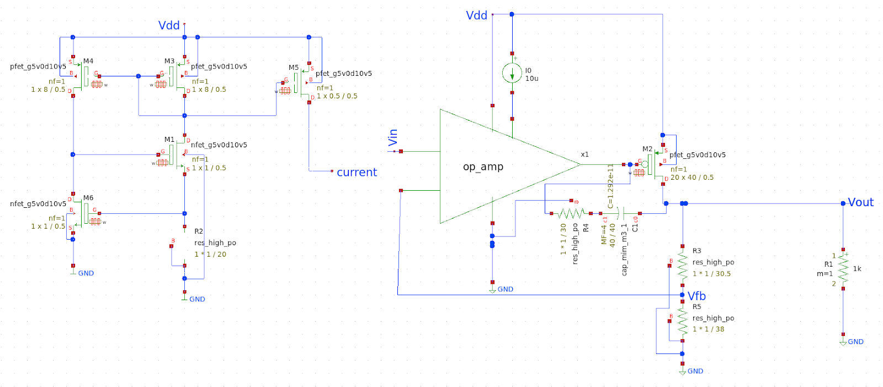
Low Dropout Regulator
No output voltage regulation → LDO
20 to 50 mV voltage drop
Maximum input voltage 8 V
Quiescent current < 30 uA
Various input / output voltages and loads
Notes:
2.5 V -> 1.2 V 60 mA
2.5 V -> 1.8 V 45 mA
3.3 V -> 3 V 35 mA

Slide 7
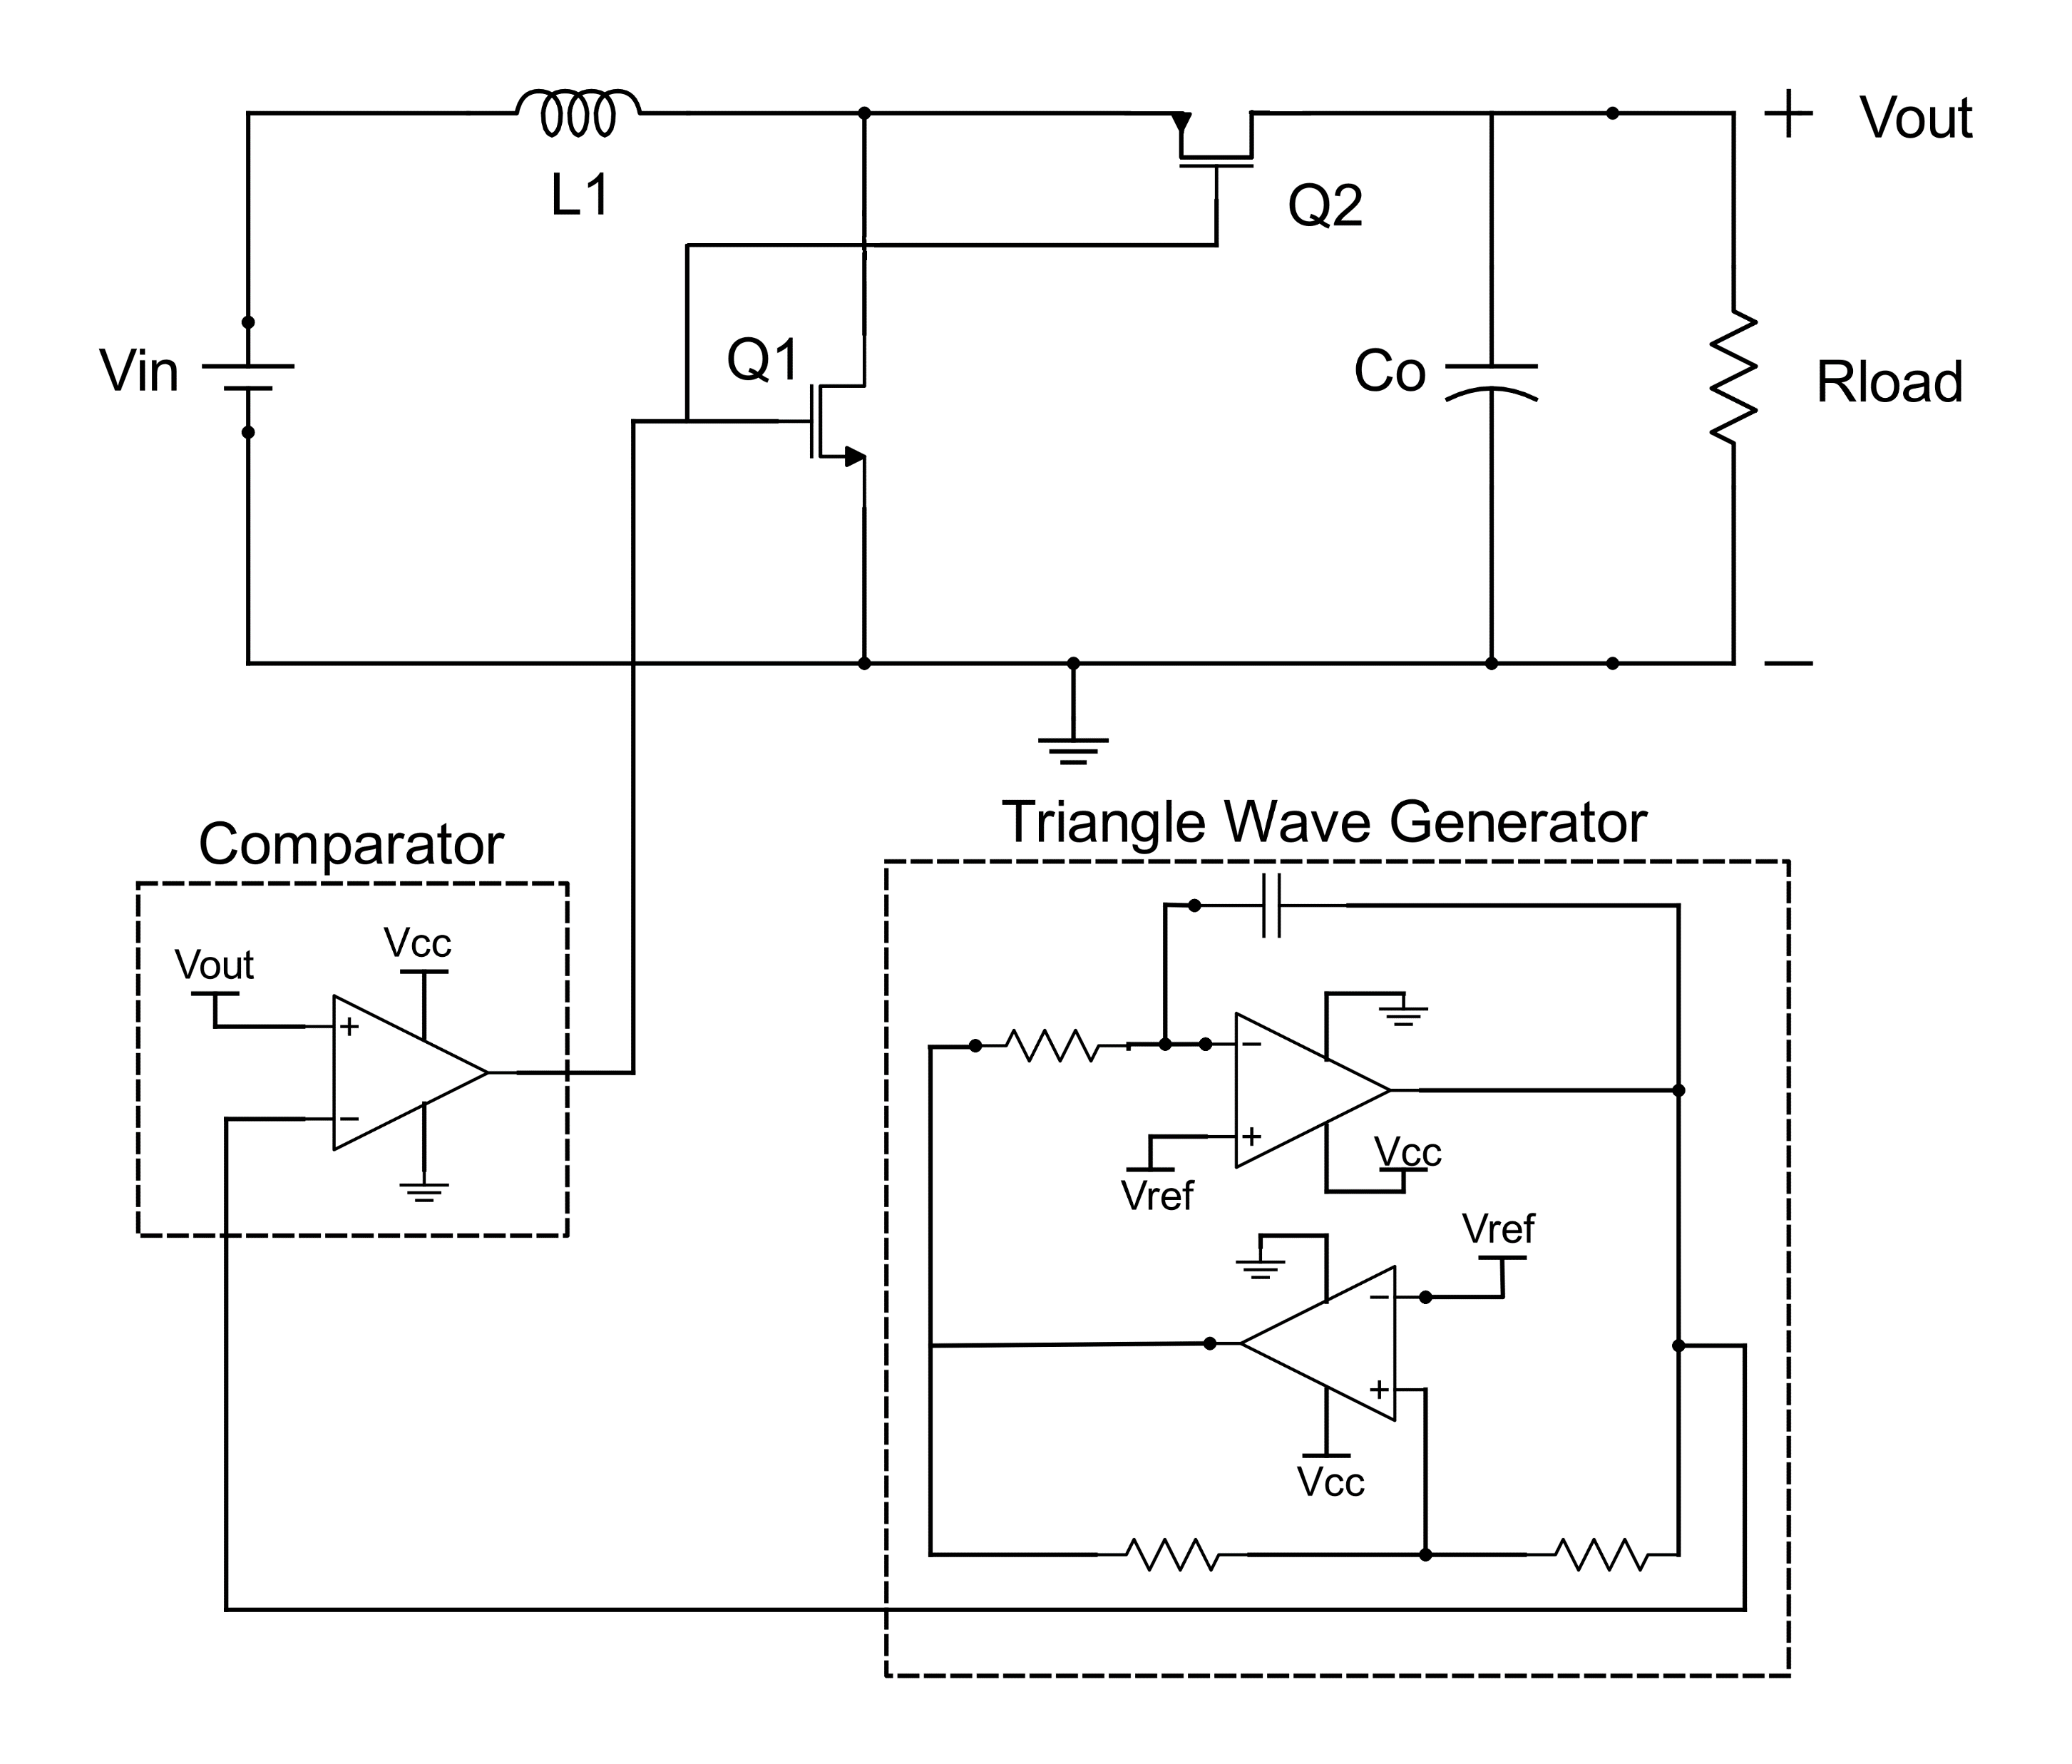
PWM Boost Converter
Triangle wave generator and comparator
Output voltage regulation
Coil inductance →
frequency of operation
mode of operation
Notes:
The PWM boost converter contains a PWM block on chip, consisting of a Schmitt trigger and an Integrator that feeds a Comparator. Through its feedback, this implementation can provide satisfying output voltage regulation but with the associated overhead in power incurred by the PWM block.

Slide 8
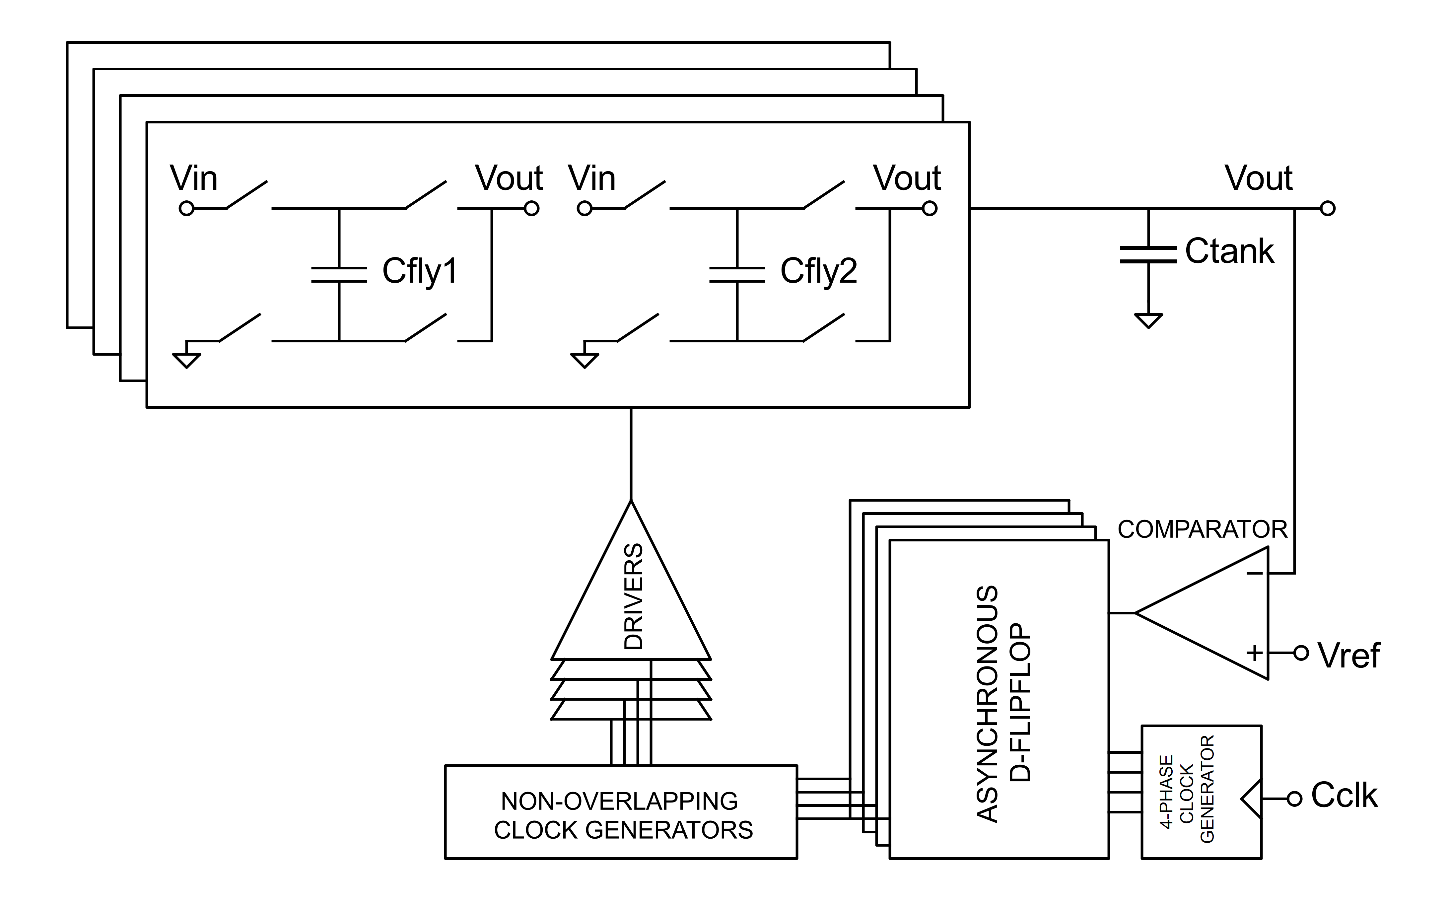
Switched Capacitor Circuit
Four-phase function
Output voltage regulation
Non-overlapping phases
Burst-mode pulse frequency modulation
Tank capacitor
Notes:
The switched-capacitor circuit will consist of a four-phase non overlapping clock generator and a four-stage parallel charge pump. It implements a burst-mode pulse frequency modulation to achieve better efficiency in a large range of loads.

Slide 9
simulation results and verification

Slide 10
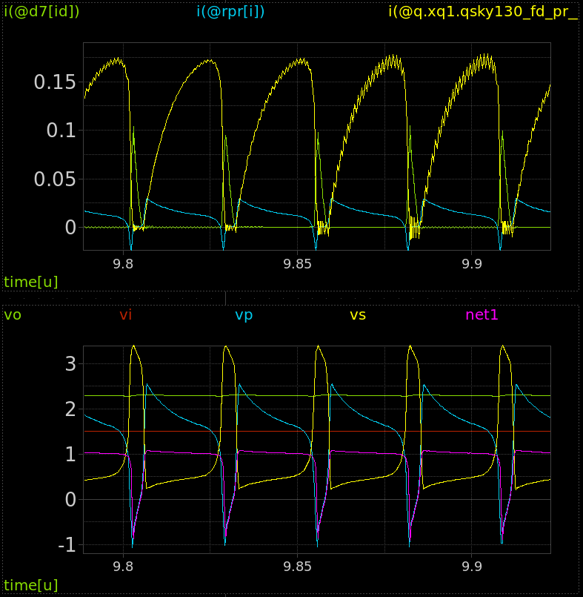
Non-PWM Boost Converter
Oscillation
On-chip / off-chip transformer versions
Efficiency vs Power consideration
Notes:
BJT 1.5 V -> 5 mA 2.2 V
1.2 V -> 5 mA 1.8 V
MOS 100 Ohm 1.5 V -> 20 mA 2.4 V, 1.2 V -> 10 mA 1.8 V, 0.7 V -> 10mA 1.7 V
50 Ohm 1 V -> 10 mA 3.7 V, 1 V -> 20 mA 2.8 V, 0.7 V -> 10 mA 1.8 V

Slide 11
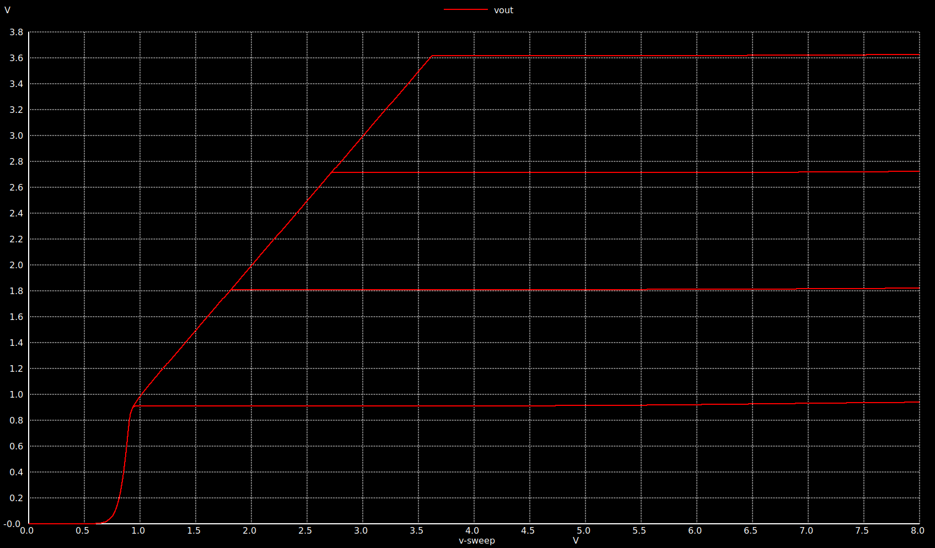
Low Dropout Regulator
Notes:
2.5 V -> 1.2 V 60 mA
2.5 V -> 1.8 V 45 mA
3.3 V -> 3 V 35 mA

Slide 12
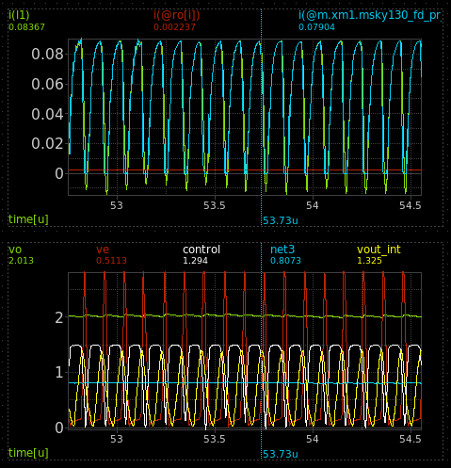
PWM Boost Converter
Regulation ability
External supplementation of inductance
Control block sensitive to input voltage drop
Notes:
1.5 V -> 2 mA 2 V 200 nH

Slide 13
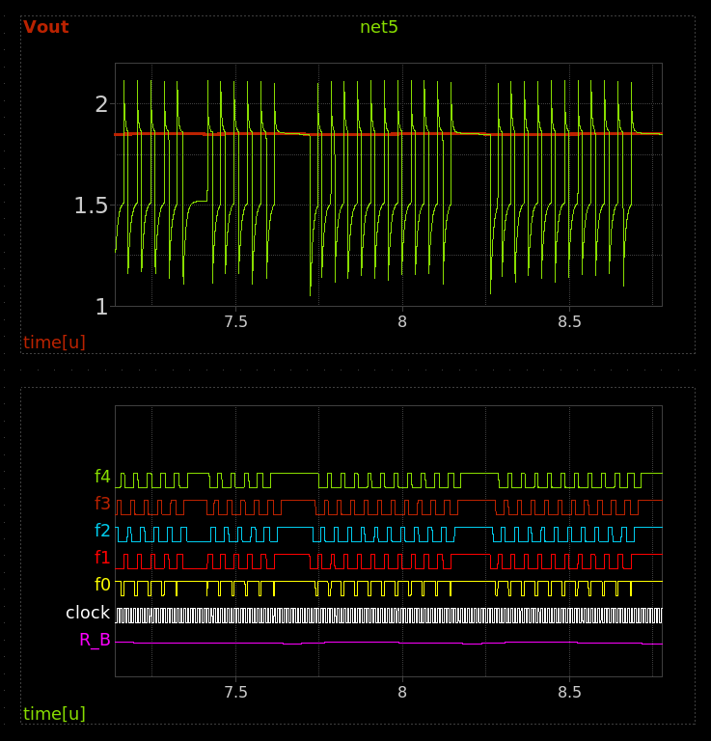
Switched Capacitor Circuit
Burst mode functionality verification
Capability directly tied to size and clock frequency

Slide 14
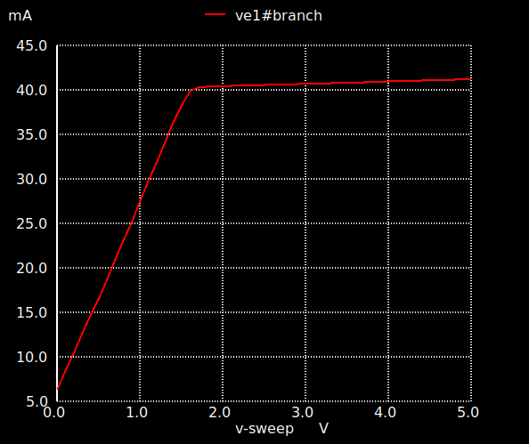
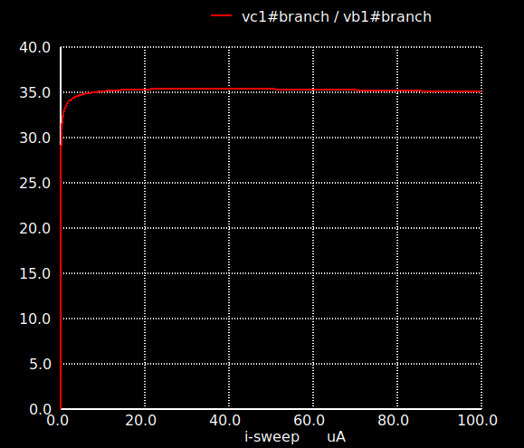
Devices

Slide 15
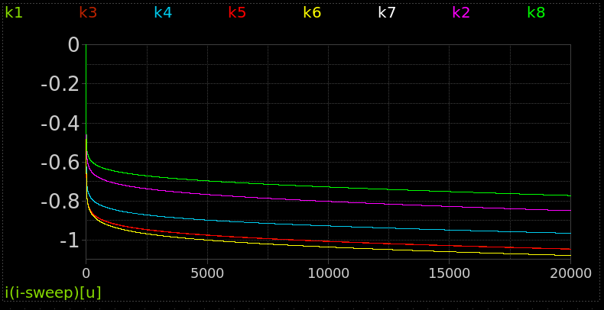
Devices

Slide 16
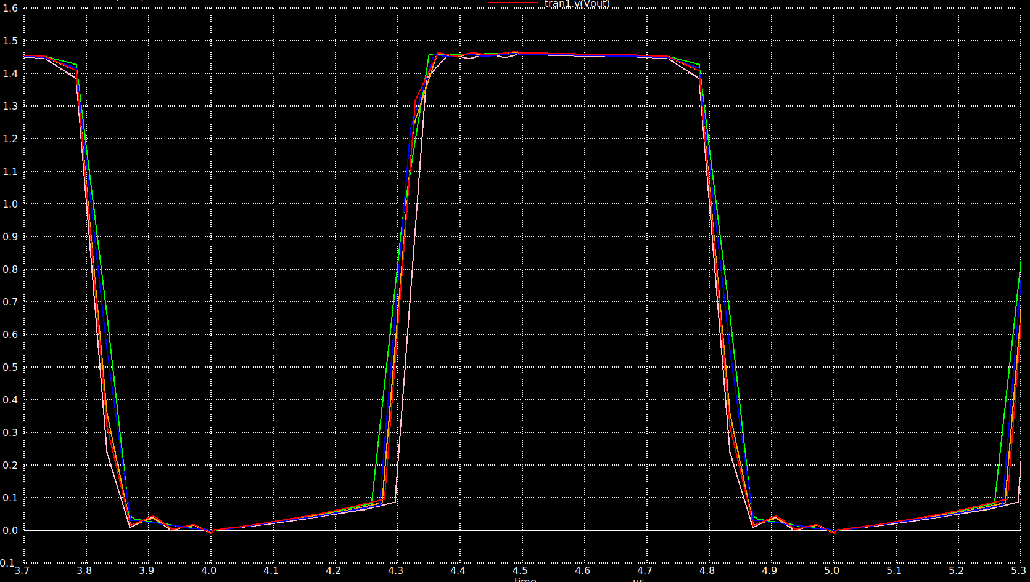
Monte Carlo Simulation

Slide 17
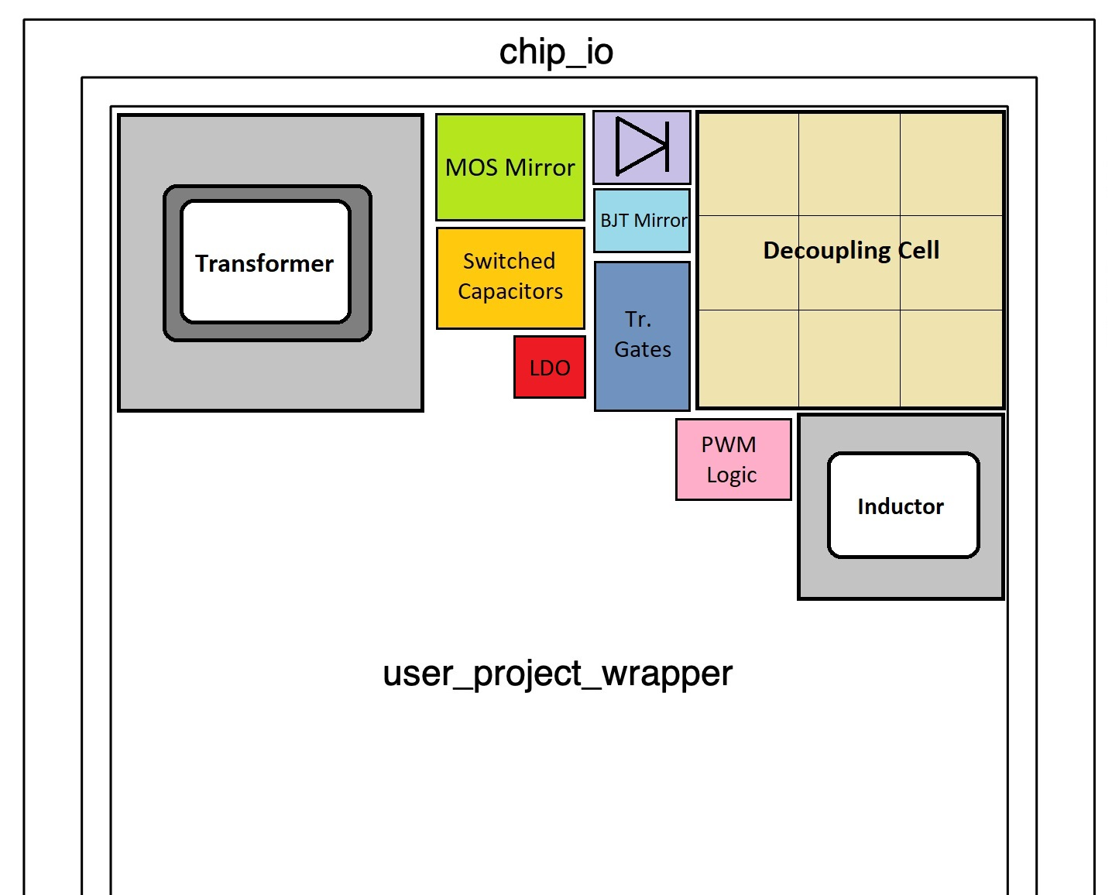
Area estimate
Our circuit should fit within 3.5 mm², biggest blocks:
On-chip Transformer
Decoupling cell

Slide 18
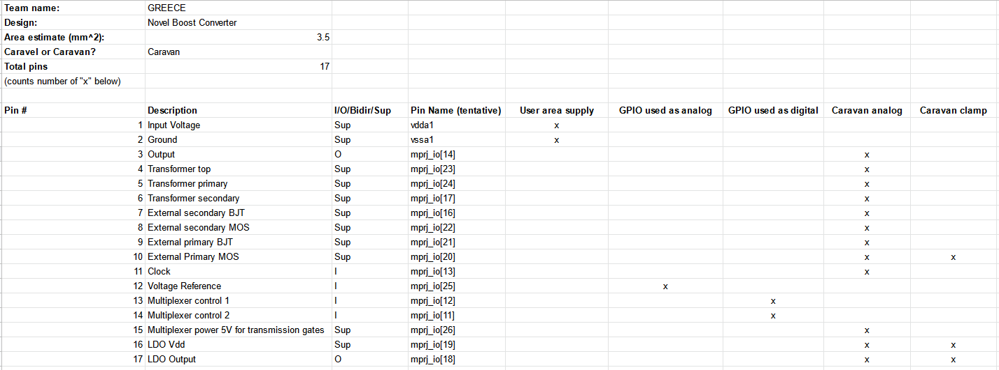
Pin-list
Need for 17 pins, 12 of which analog.

Slide 19
Caravel Sharing
Need for analog pins, some sharing possible.
Austria, 1 analog pin, 0.5 mm²
Chile1, no analog pins , 2.5 mm²
India, no analog pins , 4 mm²
Pakistan1, no analog pins , 2 mm²
Pakistan2, no analog pins , 5 mm²

Slide 20
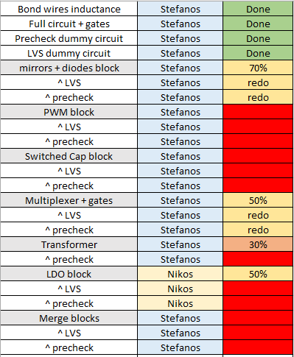
Schedule and milestones
Team full layout by October 15
Fully modular, broken into semi-independent blocks
Working in isolation and as a whole
Team merge by October 25
Arising problem solving until November 7

Slide 21
Thank you! Questions?

